Slide 1

Enabling Clinicians to Quickly Customize Views of EHR Patient Records
A Discussion with the Department of Veterans Affairs CTO
January 28, 2011

Slide 2
Purpose and Agenda
Purpose – Share MITRE’s work on medCafe, a software proto-type that demonstrates ways to significantly improve physician interaction with patient records, and discuss potential impact/use of medCafe
Agenda
Problem Statement/Challenges in Accessing Patient Information
An Overview of the MITRE medCafe Solution
Best Practices
Scaling to Production and Initial Industry Feedback
Questions and Next Steps

Slide 3

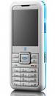


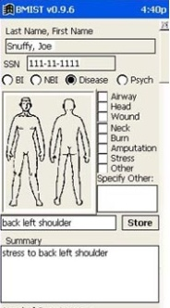

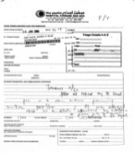


VA clinicians are often challenged in making “quick, information-supported,” patient care decisions as patient health information is located in several sources
Challenges VA Physicians Face in Accessing Patient Information
Phone
Email
Fax
AHLTA
Vista
VISTA
Outside Records
Information: Several siloed sources to consider in making patient decisions
Workflow: Current VA Physician workflow is linear and not optimal
Time: Has 15 minutes per patient
Notes:
They have, on average only 15 minutes to spend with each patient.
And have even less face time with a patient.
In this time they must
access the situation ,
to diagnose problem and
verify that old and new data confirms/ refutes this hypothesis
recommend treatment
To do this the doctor has to sift through a large amount of information, from various sources some of it not readily available.
These sources of information include:
VISTA – The system that they will currently be using to store patient records, or using as a messaging system
Email – generally Outlook
Fax – for any information that has been faxed from other clinicians or from outside sources
Phone – After a phone call, the physician has to write down the salient points of the call
And any scanned in records that are generically labeled “outside records”, and ,may include records from
AHLTA – The DoD medical system.
As a physician put it: “Everyday you need to search all these sources of information for data.”
Which leads to this…
All this information must be searched through and correlated in the physician’s head.
Which leads to this…

Slide 4
MITRE developed medCafe, an open source software proto-type that enables VA users to quickly build personal views of EHR patient records
Overview of medCafe
medCafe enables a user to build a personal view of a patient record, using a set of tools called components, each of which is separable, and substitutable, allowing for flexibility, adaptability, and system evolution
medCafe addresses Electronic Health Record Challenges with
Information: Multiple data sources
User Interface: “One-size fits all” User Interface
Multiple Capabilities: Difficulty in adding new capabilities
medCafe is a tightly-scoped, MITRE-funded, research project to determine
Feasibility of composable approach for an EHR
Engineering issues encountered
Potential future issues
Notes:
Multiple Data sources. No standard – too many standards
EHRs don’t communicate seamlessly
One size – different people, different roles, need to see different aspects of patient health record. And each patient will have specific data and unique information.
No way to highlight what is important.
Outside Records: Dr estimates 80% workload is taken dealing with these records
Uncategorized scanned in pdfs. Generally labeled with radiologist name. No real way to distinguish what it shows without looking at it.
And many more issues….
CCoD Principles:
Allow for a composable interface, giving users maximum flexibility to configure the interface to their needs
Create a framework in which to run standalone composable components
Create a set of standalone components that can be composed together to build a complete patient record.
Use an accepted data standard for all communication to components
Allow for distributing and creation of templates that mirror physician's workflow

Slide 5
medCafe Composable Design Principles
medCafe is based upon Composable Design Principles that give users maximum flexibility to configure the EHR interface to their needs
Give users maximum flexibility to configure the interface to their needs
Enable components to run “standalone”
Use an accepted data standard for all component communication
Demonstrate a patient record using the framework
Composable = Configurable + the Freedom to create what you want … it is innovation friendly!
¹Composable Capability on Demand
Notes:
Multiple Data sources. No standard – too many standards
EHRs don’t communicate seamlessly
One size – different people, different roles, need to see different aspects of patient health record. And each patient will have specific data and unique information.
No way to highlight what is important.
Outside Records: Dr estimates 80% workload is taken dealing with these records
Uncategorized scanned in pdfs. Generally labeled with radiologist name. No real way to distinguish what it shows without looking at it.
And many more issues….
CCoD Principles:
Allow for a composable interface, giving users maximum flexibility to configure the interface to their needs
Create a framework in which to run standalone composable components
Create a set of standalone components that can be composed together to build a complete patient record.
Use an accepted data standard for all communication to components
Allow for distributing and creation of templates that mirror physician's workflow

Slide 6
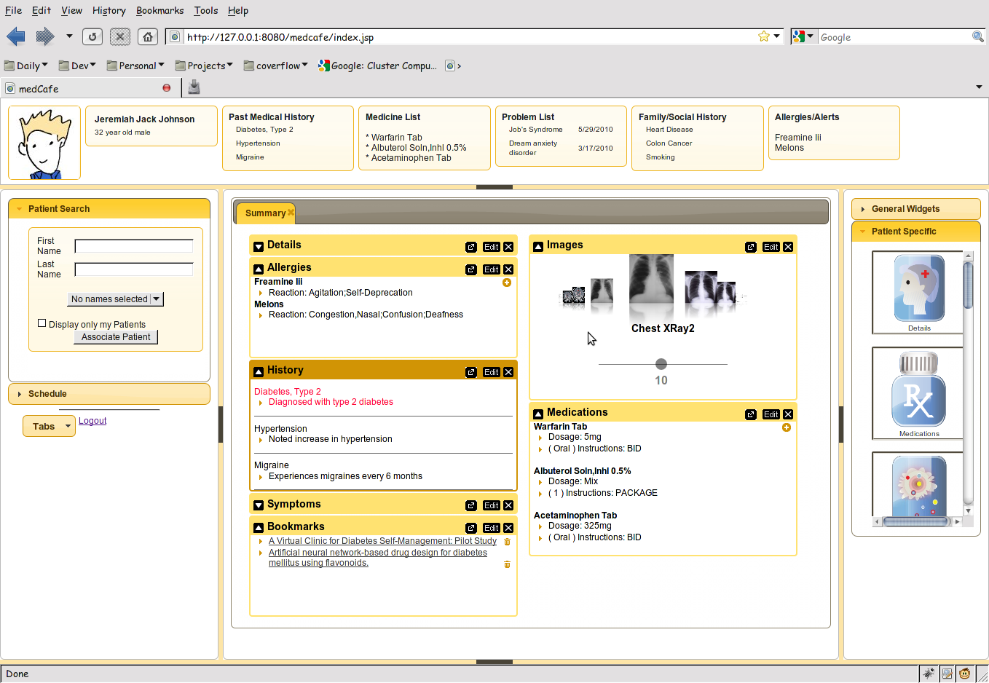
medCafe has a five-pane, flexible interface that is adaptable to a clinician’s needs
medCafe Screen Shot
Top Pane: Coversheet containing commonly required patient data.
Left pane contains
Patient look up
and scheduling functionality
Right hand pane contains list of
components that can be drag and dropped
into the center pane
Center pane contains composable patient record
Flexible 5 pane interface, adaptable to clinician’s needs. Panes can be hidden or shown.
Notes:
Framework overview:
5 major panes, North, South, etc,..
Can hide, show each pane.
Each pane can have multiple objects within it, such as tabs, widgets, sliders,treeviews etc,..

Slide 7
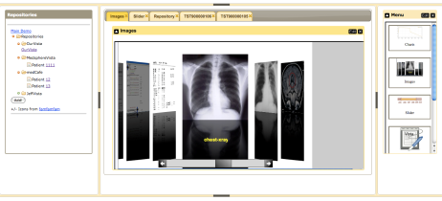





medCafe architecture is composed of three, distinct, separable layers that enable code evolution
medCafe Architecture
Composable Framework
RESTful Web Services
Tomcat Web server
Tabs
Coverflow
Date Slider
Image Viewers
Charts
T
openVista
JAVA/ J2EE
Web Services
Additional
data servers
AJAX
medCafe Interface
Application server
Health-data server
Notes:
This shows the architecture of the framework that we have built.
We have three distinct pieces that make up the medcafe composable framework.

Slide 8
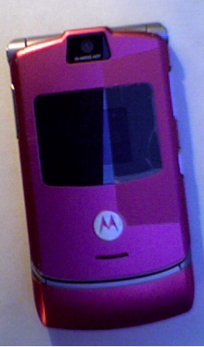

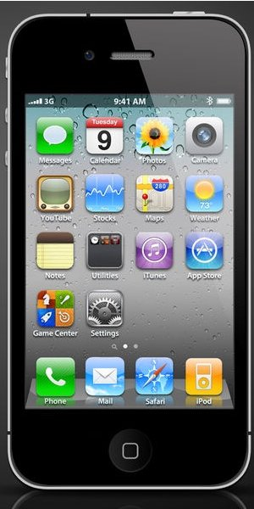
MedCafe is not a portal architecture; it is an open source, composable interface, like a smart phone
Portal vs Composable Architecture
medCafe is NOT a Portal Architecture
Portals have configurable interface, like a cell phone, and
Do not allow for substitutability of components
Interoperability is not the same as substitutability
Do not communicate through loose couplers
Web services w/o loose coupler is not a path to a pluggable architecture
Portal vendors not interested in substitutability - lose vendor ‘lock-in’
MedCafe has composable interface, like a smart phone, and enables
True substitutability
richer user experience
freedom for innovation,…
Configurable Interface
Composable Interface
“We wanted to make sure that there was no central point of failure,
where one industry player could restrict or control the innovations of any other.” ^{[1]}
1. http://source.android.com/about/philosophy.html

Slide 9
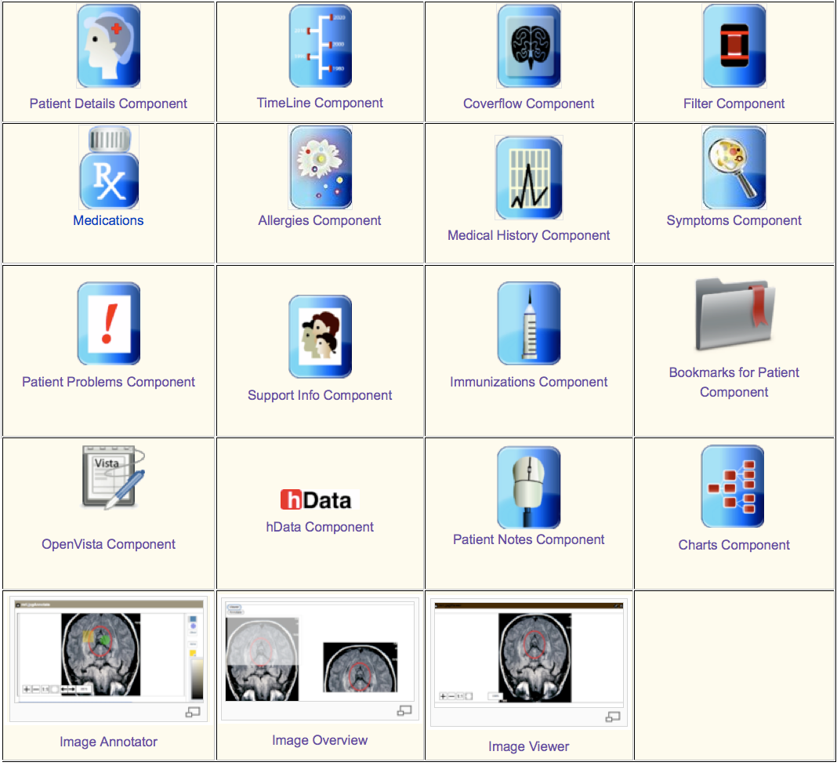
New apps can be easily added to medCafe ... users can build what they want
medCafe Components and Benefits
Components/Templates
Default/template components are provided
Add new ones as desired
User/Clinician defined views
Customize view for patients
Align with patient use cases
Per patient views
Some patients do not “fit the mold”
Modify a view for a specific patient and save it
Speeds re-engagement with a patient
?
What app would you like to add next?

Slide 10
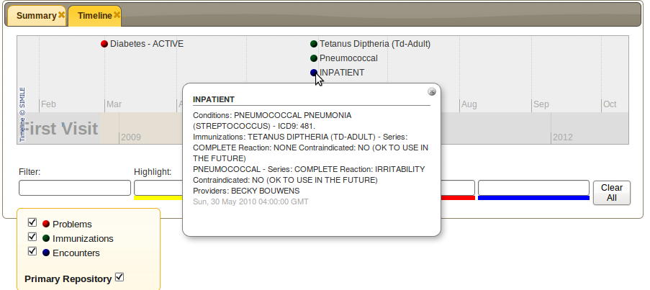
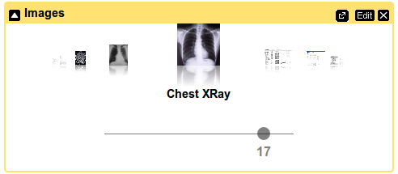
medCafe Sample Screenshots
Timeline visualizes patient history
Image viewer displays images and pdf
documents

Slide 11

medCafe Benefits of Consistent Access to Data
And, medCafe enables consistent access to data, with all components able to understand the data formats
All data sources are presented in an identical format
Allows all components to speak the same language
Components can access all data the same way
Consistent method of access
Data sources transparent to user
More component choices -> more data sources willing to play
More data sources -> more component developers
Notes:
We access the data the same way using hData
All components can display this data format.
Display can be changed – without changing data
Data can be changed without changing Display

Slide 12
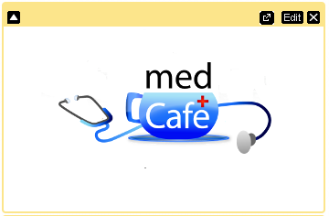




Adding new components to medCafe is easy; to add data sources, steps are well defined
A
Steps to Add Components and Data Sources
Add New Component
Create and add a component + icon
Supply RESTful web URI for data
Add New Data Source
Determine if adaptor between hData and data source exists; if none exists, create adaptor to format target data source (hData)
Expose data source as RESTful service
Add RESTful URI to medCafe
View through default component
View using existing component
Add new component
Adaptor
Data source
URI = Uniform Resource Identifier

Slide 13

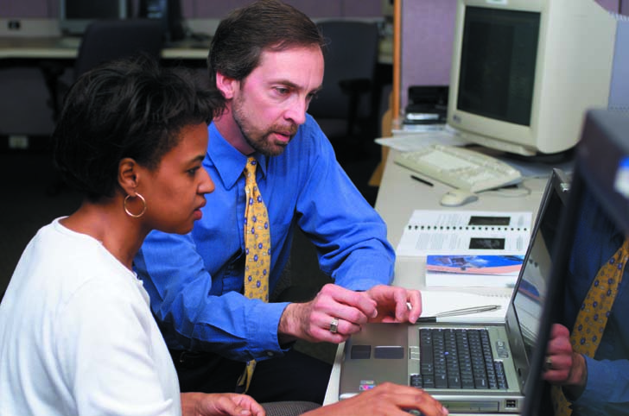

In summary, medCafe enables clinicians to interact efficiently with patient records, and enables administrators and developers to meet clinicians’ needs
Perspectives on medCafe
User Perspective
Rapidly compose patient record
Display most pertinent data first
Adapt to patient circumstance
Save state of record to reduce time
Design new components
View data from multiple data sources
Developer Perspective
Open Source framework
Build new capability as envisioned by users
Enhance existing components to user needs
Build on existing JQuery interface plug-ins
Administrator Perspective
Build the framework to practice’s needs
Start small, grow functionality over time
Add new data sources as they become available
Design new components as new capabilities are envisioned
Adapt to changing practice circumstances
Framework allows for ease of system evolution and Best of Breed

Slide 14
We learned “best practices” that we’d like to share
Best Practices
Use Modular Methodology in System Design
Build a Composable Architecture
Choose Good Loose Couplers

Slide 15
Use modular Code methodology in system design to enable ease of system evolution
Best Practices and Benefits of Modular “Code” Methodology
Best Practices
Underlying code structure is modular; separate code into
Infrastructure
Loose coupler (hData)
Presentation (through JQuery/ AJAX)
Data Layer (RESTful service layer)
Benefits
Minimizes impact on other sections if one has to be changed
If there was a federal mandate to use a different loose coupler, this code could be modified without impacting the system as a whole
Separate presentation layer from data layer for maximum flexibility

Slide 16
Build a composable architecture to enable a system to be adaptable to practice and clinician’s needs
Best Practices and Benefits of a Composable Architecture
Best Practices
Each component communicates through one data standard
XML Configuration file used to list components available to system
Move to one configuration xml file per component
Enables ability to obtain snapshot of data in component at any time
Benefits
Allows for components to be swapped in and out of the
System (by an Administrator)
Presentation of the Patient Record (by the user)
Truly Composable System
System is adaptable to practices, individual clinicians, and patient’s circumstance
Allows for Best of Breed of Components
Notes:
We access the data the same way using hData
All components can display this data format.
Display can be changed – without changing data
Data can be changed without changing Display

Slide 17
Build a Loose Coupler to enable component interoperability, and a good user experience
Best Practices and Benefits of a Loose Coupler
Best Practices
Loose coupler is data standard for components and services to communicate
Loose coupler should be simple, optimized for most use cases (think KML)
C32 is too complex and will not be good loose coupler
Analyze current events / messages, look for 80% solution
Optimizing loose coupler to be used for all cases will not enable performance
System may use multiple loose couplers
But components should only display information from a single format
“Extra” couplers should be built around real need (Images, Business Analytics )
Benefits
If all components understand data context -> much richer user interface
Notes:
We access the data the same way using hData
All components can display this data format.
Display can be changed – without changing data
Data can be changed without changing Display

Slide 18
As noted, medCafe is not a production level system; there are some scaling issues that are medCafe specific, and others that are “all-system”
Issues in Scaling to Production for medCafe and All Systems
medCafe
Security infrastructure - needs to exist for single sign on, role-based access
User Interface - scale interface for production level data sets
Data standards - health data ontology
Business rules - enforced with Templates
Data entry – write back to the data source
All Systems
Governance - Manage component libraries
Discoverability - Enable discoverability of components
Test Framework - Develop Test Infrastructure framework for new components
Service Access - Develop mechanism to alert user to service availability
Business Analytics – Allow users to rate and show components

Slide 19
medCafe: Industry Feedback
Initial feedback on medCafe has been positive, and we have heard that we have “solved a lot of the really hard problems”
From meeting with Open Health Tools
Rob Kolodner,
Chief Technology Officer for Open Health Tools
Former National Coordinator for Health IT
Skip McGaughey
(Executive Director) of Open Health Tools
Co Founder of Eclipse
“You solved a lot of the really hard problems”
“there are many who want to work to solve the next generation of the UI [user-defined GUIs], which you've already thought through most of”

Slide 20
Questions and Next Steps?
What are the potential impacts of medCafe on
VLER
VA-DoD EHR Way Ahead
Healthcare Informatics - AViVA
VistA Modernization
Potential Next Steps
Test out medCafe
Demo medCafe to other VA audiences
Host medCafe on MDWS

Slide 21
MITRE Team
MITRE VA Client Representatives/Strategists
Lisa Bembenick
Art Hamerschlag
MITRE Research team
Mary Greer
Gail Hamilton
Jeff Hoyt
MITRE Chief Engineers
Mary Pulvermacher
John Shottes

